Slide 1
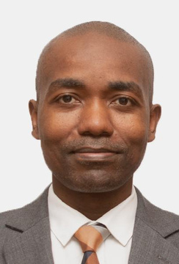
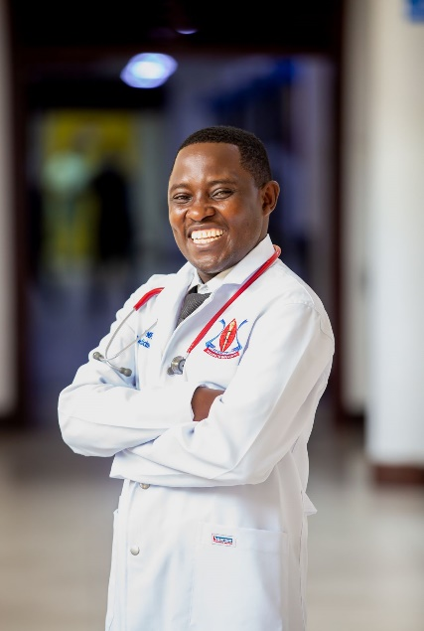
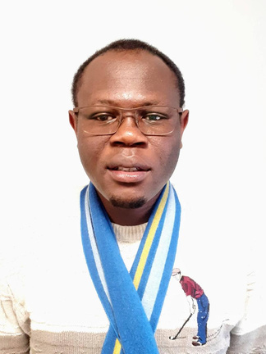
NEW PUBLICATION ALERT!!
Published by The Lancet Global Health
Prof.Hendry Sawe
Dr.Juma Mfinanga
Dr.Gimbo Hyuha
Dr. Ibrahim Simiyu
The burden of multimorbidity-associated acute hospital admissions in Malawi and Tanzania: a prospective multicentre cohort study
Stephen A Spencer, Nateiya M Yongolo, Ibrahim G Simiyu, Prof Hendry R Sawe, Prof Paul Dark,Prof Stephen B Gordon, Matthew P Rubach, Prof Rachel Manongi, Julian T Hertz, Gimbo Hyuha, Grasiana Kimario, Juma Mfinanga, Prof Blandina T Mmbaga, Prof Adamson S Muula, Mulinda Nyirenda, Jacob Phulusa, Laura Rosu, Alice H Rutta, Francis Sakita, Charity Salima, Prof Miriam Taegtmeyer, Sarah Urasa, Sarah A White, Jamie Rylance, Felix Limbani, Prof Eve Worrall, Ben Morton

